Slide 1
We light the candle

Slide 2
https://www.google.com/search?q=shine+jesus+shine&source=lmns&tbm=vid&bih=738&biw=1522&rlz=1C1GCEU_en-GBGB1024GB1024&hl=en-US&sa=X&ved=2ahUKEwjH36bgnuD7AhXzpicCHbOmAdoQ_AUoAXoECAEQAQ#fpstate=ive&vld=cid:d5159bcb,vid:gr5Y63bDNNg

Slide 3
RESPECT & COMPASSION

Slide 4
Looking out at the world

Slide 5
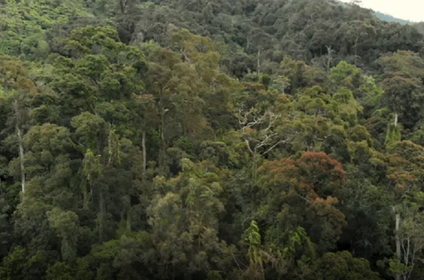
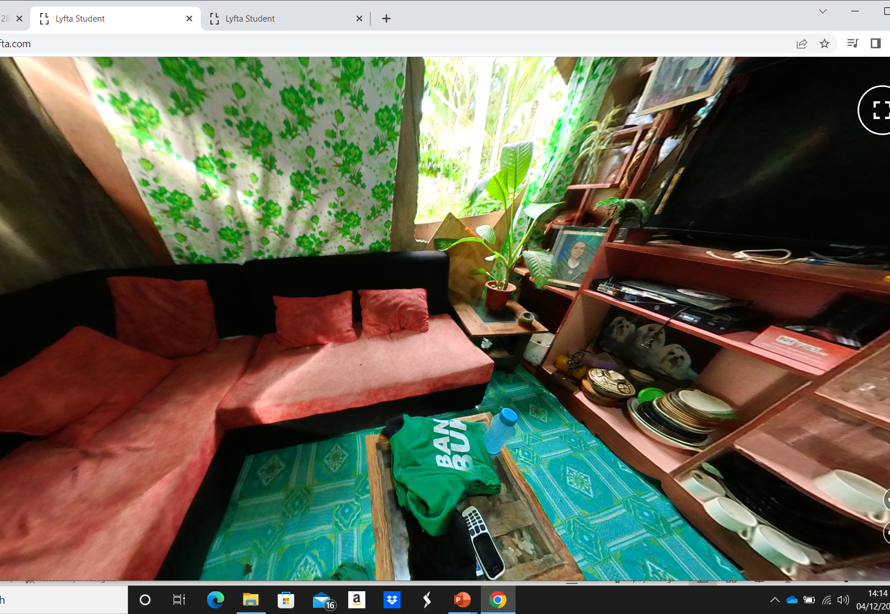
RESPECT & COMPASSION
Like the Ethiopian villagers of Awra Amba the people we are visiting today have very little money and live a very simple life.
However, they are generous with what they have and with their time.
They care greatly about the forest around them and the wildlife it supports.

Slide 6
Video to 0- 5mins
6.53-7.20- role and duty. 7.40-7.46 – protecting the world.
Lyfta Navigation

Slide 7
The Forest Guards are also
“Citizen Scientists”.
They carry out checks and measurements and record information that can be added to the information collected by other people and then used by scientists to work out the populations of animals , plants and birds in the wild areas of the world.
This help us to work out if we are doing is beginning to improve the environment and to help Nature.
The image above shows how in Scotland, pairs of breeding golden eagles increased from 442 in 2003 to 508, an increase of about 15%

Slide 8
Reflecting on what we have learnt

Slide 9
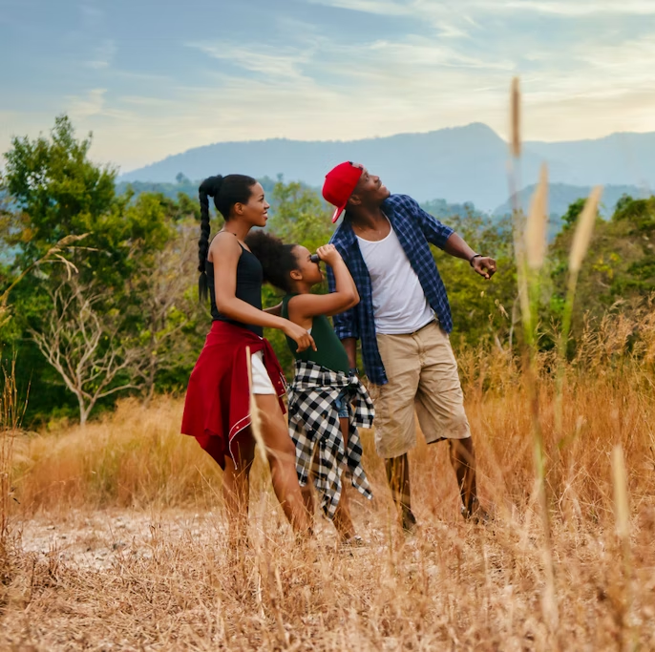
Anyone, anywhere can be a Citizen Scientist
Citizen science captures all kinds of data!
For example. the number of insects, animals or plants seen in a small area, such as a garden or school playing field

Slide 10
Acting on what we have learnt…

Slide 11
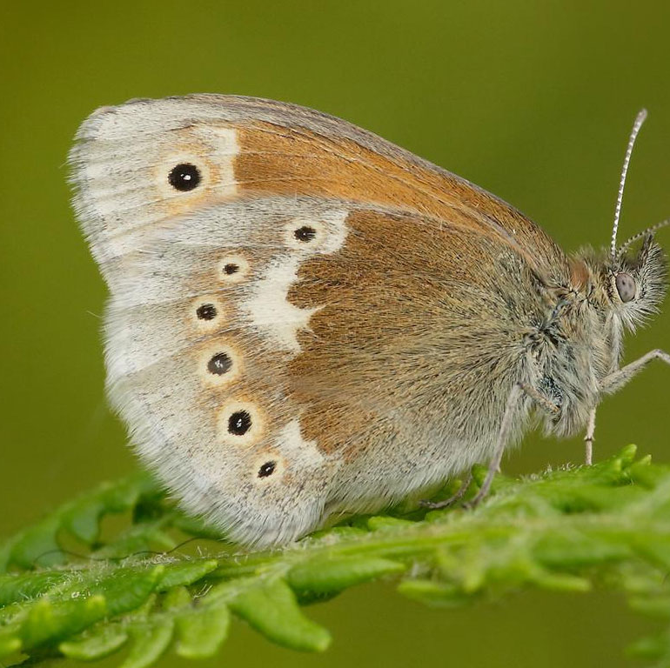
Next summer we will be Citizen Scientists at school
Now that we have planted lots of butterfly friendly plant son our school field we can take part in The Big Butterfly Count, in July and we will record the numbers of butterflies/ moths we can see in a fifteen minute period

Slide 12
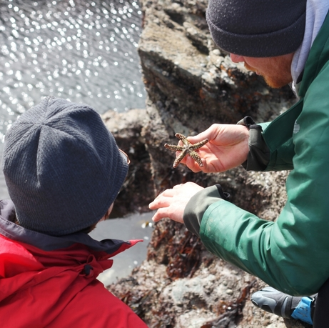
You can get involved in Devon
Shoresearch is a Wildlife Trust run citizen science project that trains volunteers to identify and record the wildlife on shores across the UK. The data collected helps experts to monitor our fragile sea life and better understand the effects of pollution, climate change and invasive alien species.
https://www.wildlifetrusts.org/get-involved/other-ways-get-involved/shoresearch

Slide 13
Dear Lord
Help us to show Respect and Compassion for others and for Nature itself.
Help us to be good citizens of the Earth and to play our part in protecting our environment.
Amen

