Slide 1
Early Reading Meeting
September 2022

Slide 2
What do we want for our early readers at Ilsington?
▶ To promote and encourage a lifelong love of reading
▶ To develop an interest in and love of books, encouraging children to become attentive listeners and independent and reflective readers
▶ To be able to read a variety of different words using their phonetic knowledge and feel confident to have a go

Slide 3
Systematic Synthetic Phonics
▶ Phonics is one method of teaching children how to read and write.
▶ Phonics is all about sounds. There are 44 sounds in the English language, which we put together to form words.
▶ Some are represented by one letter, like ‘t’, and some by two or more, like ‘ck’ in duck and ‘air’ in chair.
▶ Children are taught the sounds first, then how to match them to letters, and finally how to use the letter sounds for reading and spelling.
▶ Synthetic phonics refers to ‘synthesising’, or blending, the sounds to read words. It is based on the idea that children should sound out unknown words and not rely on their context.

Slide 4
Blending and segmenting
Blending
▶ Saying the individual sounds that make up a word and then merging or blending the sounds together to say the word – used when reading. E.g. ‘c-a-t’ is blended to ‘cat’
Segmenting
▶ This is the opposite of blending (see above). Splitting a word up into individual sounds – used when spelling and writing. E.g. cat is c-a-t
▶ These processes are the reverse of one another. Children need to be able to do both in order to read

Slide 5
So what?
▶ Bug Club Phonics is the reading programme that Ilsington uses to help teach your child to read
▶ Children access Phonics sessions every day to increase their reading and writing ability
▶ During Phonics sessions, children are introduced to new sounds (phonemes) and the way to write these (graphemes)
▶ Children also receive a weekly language session which helps children with tricky words

Slide 6
What are tricky words?
▶ Tricky words are those words that are partially decodable but sound different to how they look
e.g. he, she, said, the, of, I, go, was
▶ Not all the word is tricky, just part of it.

Slide 7
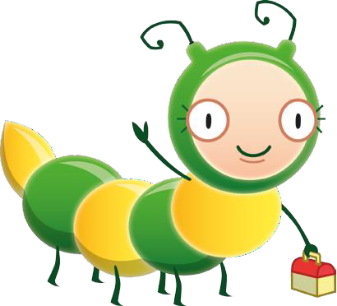
Bug Club Books
▶ Every grapheme taught in a Phonics session has book/s with that grapheme in, to allow children to practise applying reading that grapheme
▶ They also contain the tricky words your child has learned in Language Sessions
▶ These are allocated to your child on ActiveLearn (the BugClub website) at the end of the week, allowing them to practise the graphemes they have learned that week in the context of a book
▶ There are also fun reading and spelling games for each grapheme that will be allocated weekly. Please encourage your child to play these as well as reading the book/s they have been allocated

Slide 8
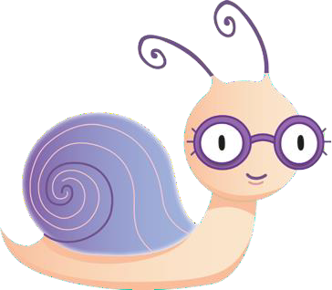
Reading with your child
▶ Notes for parents on the inside front covers
▶ Practise high-frequency words and sounds that appear in the book with your child
▶ Don’t worry if your child struggles on the tricky words
▶ You can use the games and questions for discussion with your child

Slide 9
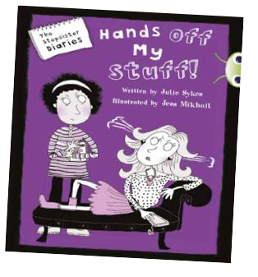
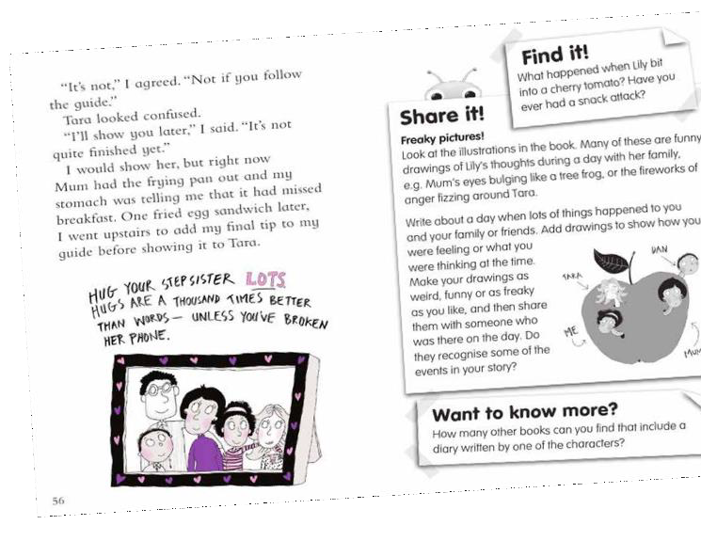
Using the Bug Club eBooks
▶ After reading:
▶ Children’s activities on inside back covers
▶ Play the games to encourage your child to read back through the book
▶ There are ideas for making or drawing things

Slide 10
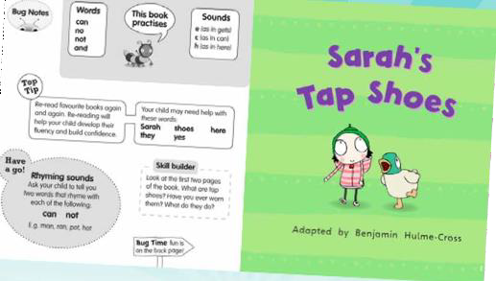
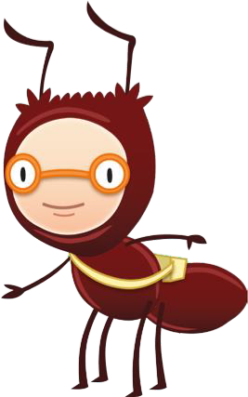
Why are we using eBooks?
▶ Your child can enjoy reading books on screen and completing fun quiz questions found in the eBooks
▶ Click on the bug’s face to access these!
▶ The quiz questions will help the children practise their reading skills, such as blending a grapheme or retrieving information
▶ The EYFS and KS1 eBooks are also audio-books, so children can enjoy hearing an expressive reading of the story

Slide 11
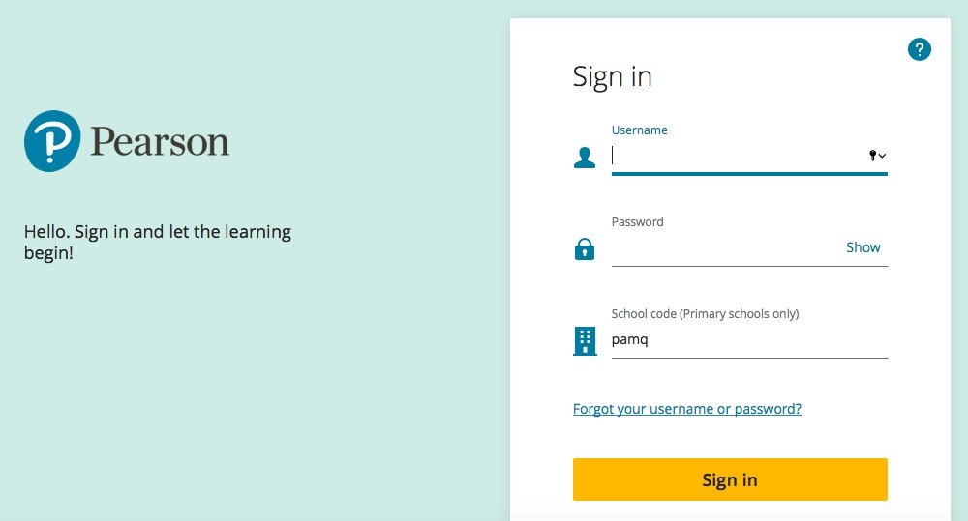
Accessing the eBooks
▶ Each child has their own login details to the ActiveLearn Platform which hosts Bug Club. They can read their eBooks here

Slide 12
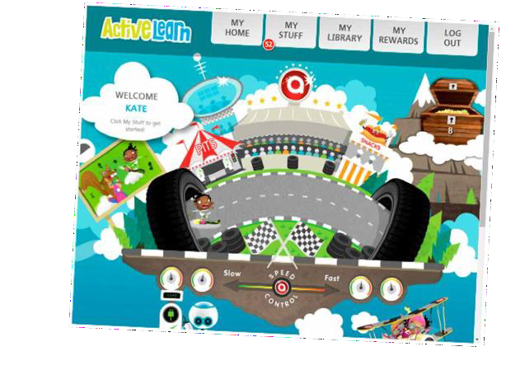
A child’s homepage
▶ Your child will see their eBooks and games in “My Stuff”
▶ We will allocate eBooks according to your child’s reading level
▶ Your child can have multiple eBooks in My Stuff at any one time

Slide 13
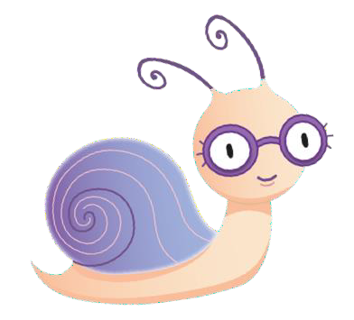
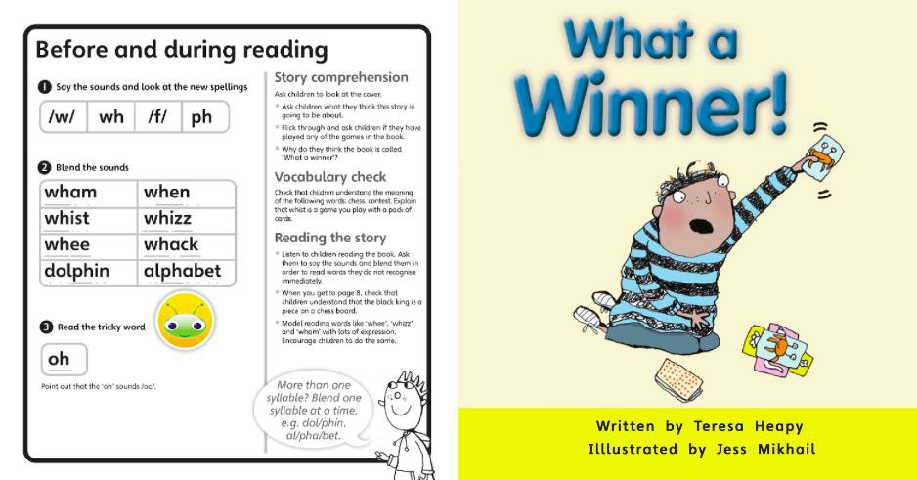
Reading an eBook
▶ Look at the inside front cover notes and activities with your child
▶ Read the book and, where they appear, click on the bug icons to open the quiz questions
▶ Your child can come back to their books at any time to finish the quiz questions

Slide 14
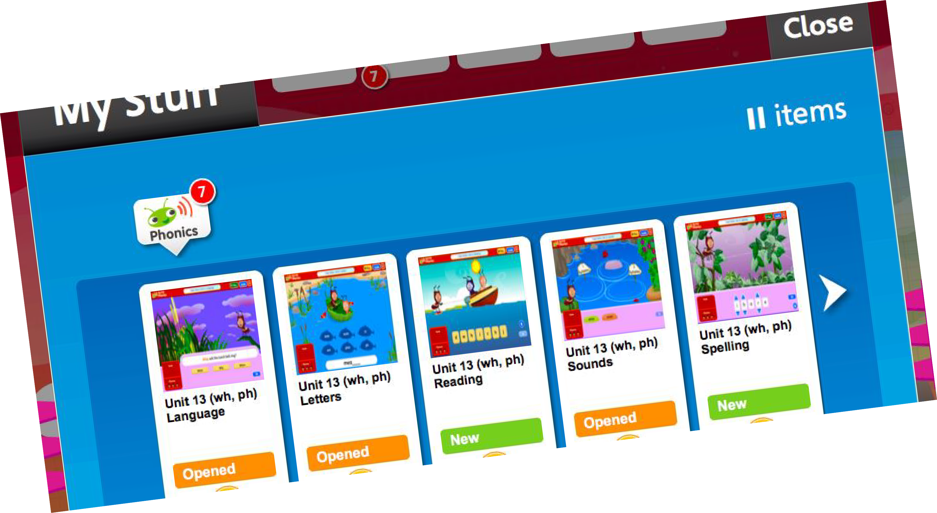
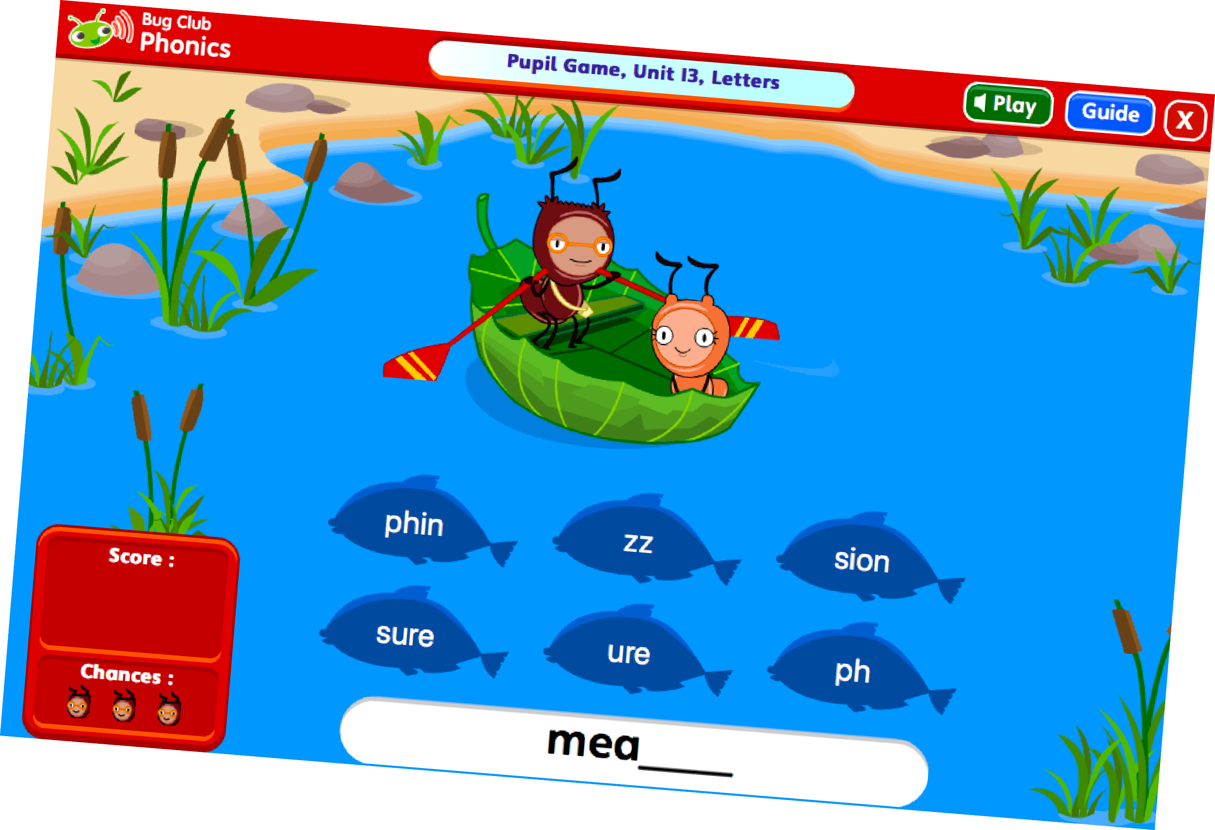
Playing the language games
▶ Playing these games counts as reading!

Slide 15
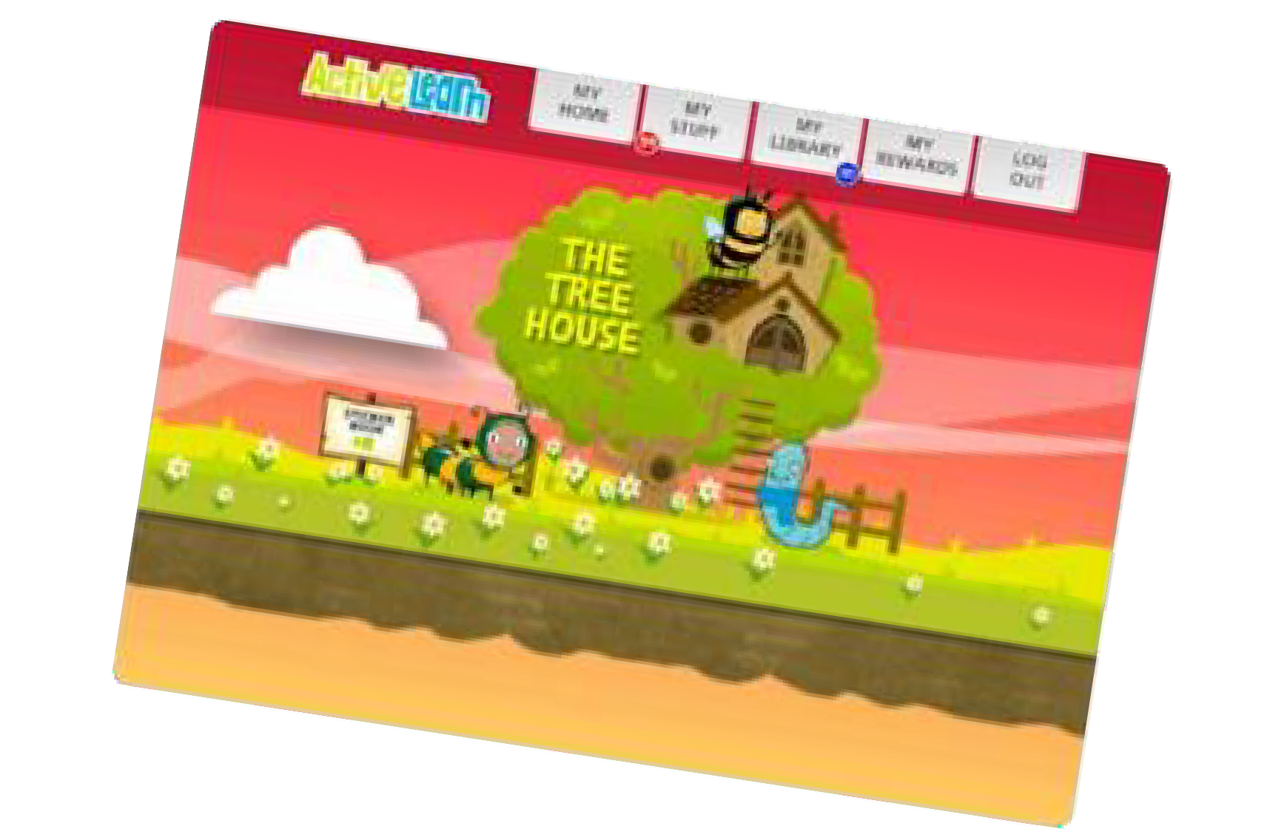
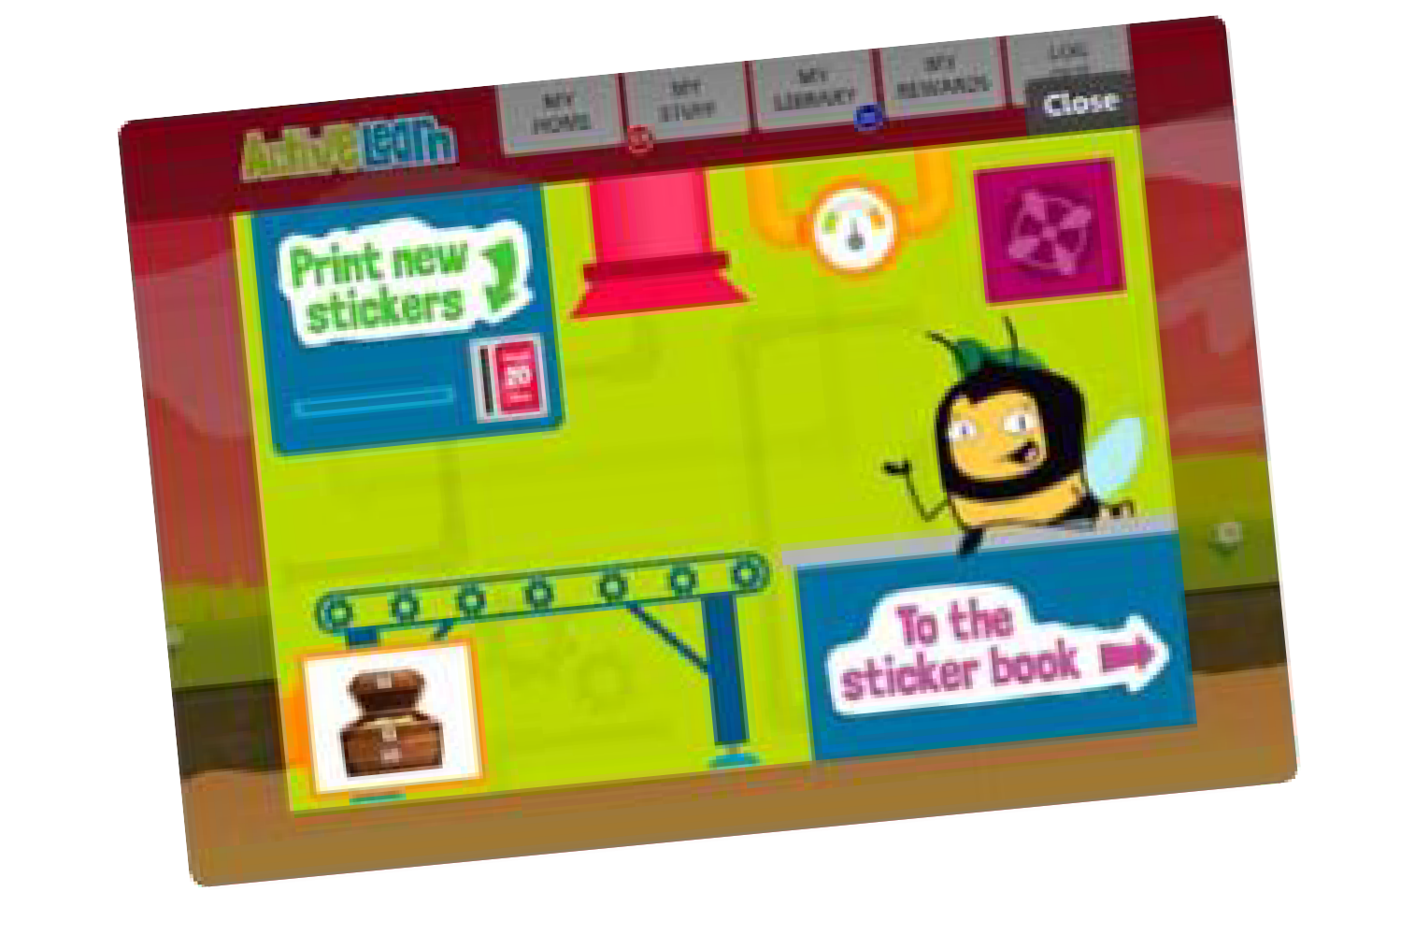
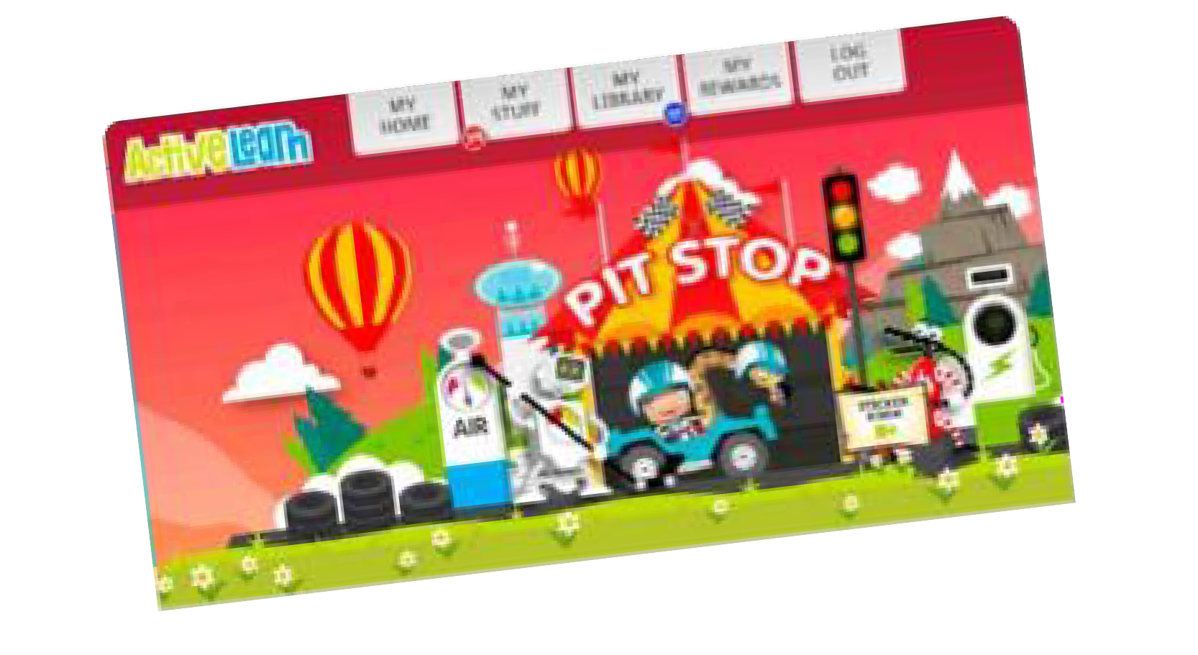
Rewards
▶ When your child has finished all of the quiz questions in an eBook, they will gain some coins
▶ When they have read a few eBooks, they will have enough coins to gain a reward
▶ They can spend their coins in one of the multiple ActiveLearn
reward worlds on games, items for their treehouse etc.

Slide 16
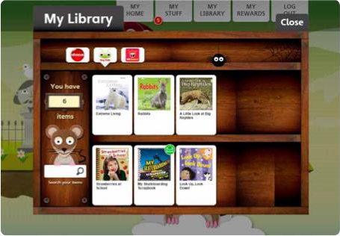
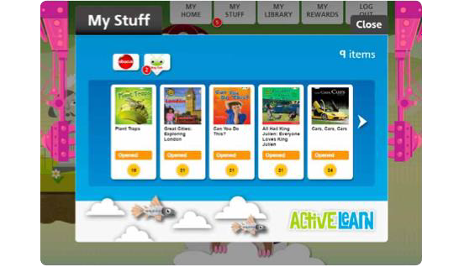
My Library
▶ When your child has finished an eBook, the eBook will move to My Library where they can read it again, if they want to
▶ We recommend that each book is read three times
▶ They can choose a new eBook from ‘My Stuff’

Slide 17
Getting the most out of the eBooks
▶ Encourage your child to attempt all quizzes
▶ Your child’s teacher can track their progress and help them with types of quiz questions they struggle with by building these into lessons
▶ Allow your child to read a favourite eBook again to build their confidence and stamina – this will lead to a ‘storyteller’ voice

Slide 18
Effects of parents and schools
▶ The younger a child is, the stronger the impact of reading with a parent. At age 5 it has 5 times the impact of school!
▶ Research shows that parental engagement has a
significant impact on children’s ability – the more you read with your child, the better they get

Slide 19
Fluency
▶ Fluent decoding allows us to understand what we read. This is because a fluent reader is more accurate and speedy in their reading. They can read many words ‘at a glance’. This is only achieved through re-reading texts and practice
▶ As children gain fluency, their motivation increases, they start to enjoy reading more and are willing to do more of it
▶ In Year 1, children are considered fluent if they can accurately read an age appropriate text at 60 words per minute
▶ In Year 3, this rises to 90 words per minute

Slide 20
Expectations for Home Reading
▶ Please read with your child at least three times a week
▶ Log this in their Reading Record Book
▶ Encourage them to read widely! BugClub eBooks are their ‘bread and butter’ and we want them to experience a wide range of text types and authors, so favourite books, comics etc that you share together are great too.
▶ Encourage your child to read each Bug Club eBook three times to develop confidence, fluency and their ‘storyteller voice’
▶ Keep practising Tricky Words

Slide 21
Expectations for Home Reading
▶ Accelerated Reader
▶ This is Ilsington's offer for children who have ‘graduated’ from Bug Club and finished their Phonics program of learning
▶ Children bring home a physical book based on their ZPD to read independently, although we still encourage them to read to an adult
▶ Children complete a 5-10 question quiz on their book in school when they have read it and can choose a new book from the library

Slide 22
Expectations for Home Reading
▶ If your child accesses Accelerated Readerthey should still read at least three times a week at home
▶ Please log this in their Reading Record Book
▶ You can support your child by asking questions to get them thinking about what they have read in new ways.

Slide 23
Going forward…
▶ Throughout the country, children in Year 1 will all take part in a phonics screening check. This will happen the week beginning Monday 12th June 2023. Children in Year 2 will also take the check if they did not achieve the required result when in Year 1 or they have not taken the test before.
▶ This consists of real words and nonsense words to assess children’s
phonic accuracy and decoding skills

Slide 24
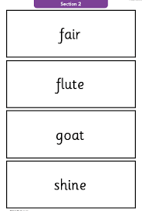
What will they need to do?
▶ The test contains 40 words. Each child will sit one-to-one and read each word aloud to a teacher. The list of words the children read is a combination of 20 real words and 20 nonsense words

Slide 25
Going forward…
▶ Children who pass the Phonics Screening Check will move on to the Non Nonsense Spelling programme that will look at how we can spell words.
▶ Children who do not pass the Phonics Screening Check will
require extra Phonics teaching
▶ This will be done through interventions and will receive a bridging book to allow them to become fluent in their reading before going onto Accelerated Reader.

Slide 26
Any questions?

