Slide 1
https://www.google.com/search?q=youtube+video+meaning+of+metacognition+for+kids&rlz=1C1GCEU_en-GBGB1040GB1040&oq=youtube+video+meaning+of+metacognition+for+kids&gs_lcrp=EgZjaHJvbWUyBggAEEUYOdIBCjExMDQwajFqMTWoAgCwAgA&sourceid=chrome&ie=UTF-8#kpvalbx=_zOQ7ZOPBFIvMgQbcv6_wDg_45
TEACHER NOTES
Youtube an explanation of what meta cognition is.
What a meta cognitive learner does when meeting a task:
Assess the task
Consider own strengths & weaknesses
Plan
Do
Reflect
Strategies a meta cognitive learner uses:
Self – questioning
Annotated drawings
Lists
Concept maps
Reciprocal teaching
A metacognitive learner can:
Acquire
Retain
Transfer
EYFS Prime areas- Communication & Language: Listening & attention, Understanding, Speaking. PSED Managing feelings & behaviour.
KS1&KS2The problem solving and metacognitive discussion planned for today is designed to encourage children in their ability to face challenge and to think laterally. These skills are intrinsically linked to the Maths curriculum.
National Curriculum- Mathematics- A high-quality mathematics education..provides a foundation for understanding the world, the ability to reason mathematically, an appreciation of the beauty and power of mathematics and a sense of enjoyment and curiosity about the subject.
Through exploring their ability to reason and talk about their own learning we are enabling out pupils to be able to: “reason mathematically” by following a line of enquiry, conjectures, relationships and generalisations and developing an argument, justification or proof using mathematical language.
We are helping our pupils to: solve problems by applying their mathematics to a variety of routine and non routine problems with increasing sophistication, including breaking down problems into a series of simpler steps and persevering in seeking solutions.
English- Pupils should also be taught to understand and use the conventions for discussion and debate.

Slide 2
Tuesday April 18th 2023

Slide 3
This week’s word of the week is metacognition
Metacognition is the process of thinking about one's own thinking and learning

Slide 4
You began to learn about metacognition last year with the 4 Rs Why did we pick the four different animals we use to help us to remember the 4Rs? Can you remember what they are and how they help you as you learn?

Slide 5
The Blue six
What do I already know?
What strategies do I have that I can use to help me?
What do I know about myself and how I react when I meet a problem?
Plan it
Monitor
Review/reflect

Slide 6
Today we are going to further explore and develop our understanding of metacognition so that we can all improve our ability to cope with challenge, to solve problems and to learn more effectively.

Slide 7
You will be working in teams to try to complete a range of puzzles and will need to think and talk about how you think as you work through them. Then as a whole school we will come together and discuss what we have found out.

Slide 8
We hope to create a set of images that we can use in each class to help us all to think about thinking and the steps we can take when we are faced with a problem.

Slide 9
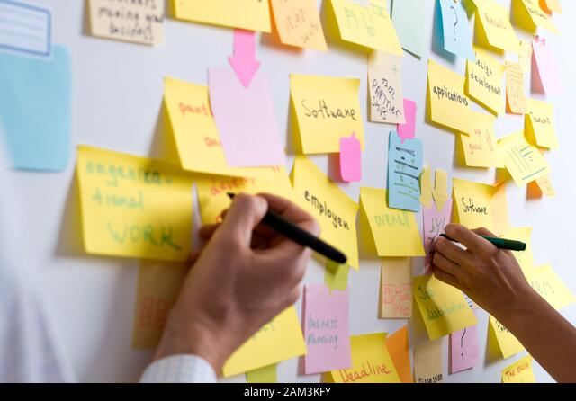
As we move through the day we also want you to write some Post its- celebrating the good learning and teamwork that you see other people doing.

Slide 10
So let’s begin! We will be meeting challenges today so we need to settle our minds and get ready to learn…
Stand strong or tall with both feet on the floor.
Imagine breathing through the soles of your feet, inhaling from the ground into your body.
Feel warm, vibrant energy sourcing from the centre of the Earth, and coming up through your body.
Notice the breathe coming up your legs, into your torso and rising up into your body, while connecting you firmly to the Earth.
You might choose to lift your arms in an upward motion to encourage this rising of breath and energy from the Earth up into your body.
Continue to breath deeply “through the soles of your feet” and imagine yourself firmly grounded and rooted to the planet.

Slide 11
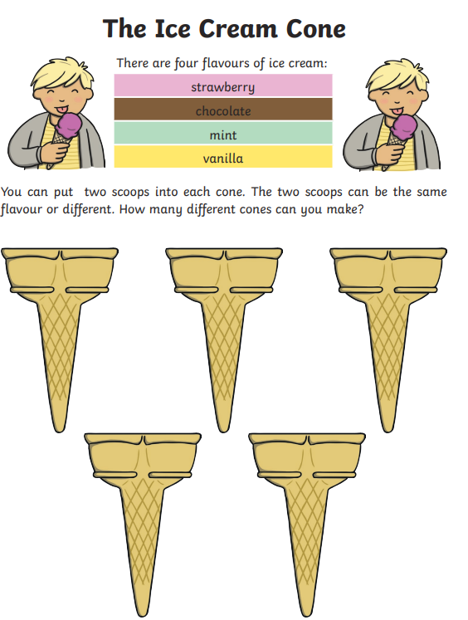
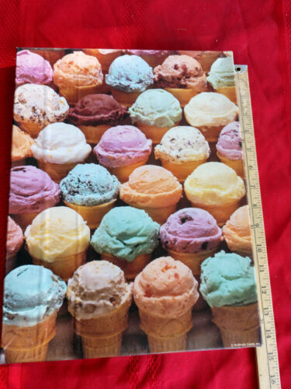

Slide 12
This is a Year 6 SATS question- I winder if you could find a way to solve it??

Slide 13
As you experience challenge today and as you think about HOW you are thinking- discuss with your friends and the adults supporting you. Have fun!!

Slide 14
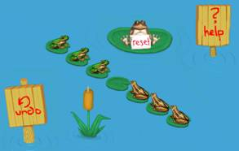
Suppose there were 7 lily pads in a row. 6 frogs sit on 6 lily pads, with an empty one in the middle. The 3 red frogs on the right lily pads want to switch places with the 3 blue frogs on the left lily pads. To do it, they may either: a) hop over one empty lily pad at a time, or b) hop over a frog onto an empty lily pad, like jumping your opponent in the game of checkers. How many moves would it take you to help the frogs switch lily pads? Could you do it in less than 17 moves?

Slide 15
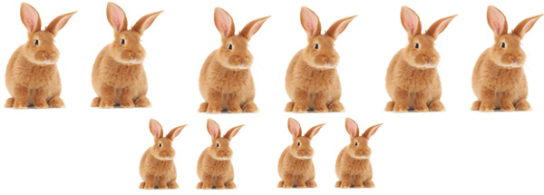
Fibonacci’s rabbit puzzle
No rabbits leave the field- there is always enough to eat.

