Slide 1
We take time to be quiet and to light the candle.

Slide 2
Small school
Big Heart
Big ideas
Big picture
Our school motto

Slide 3
Looking out at the world
Learning about DIVERSITY

Slide 4
DIVERSITY
the state of being diverse; variety.
"there was considerable diversity in the colours children wore"
2. the practice or quality of including or involving people from a range of different social and ethnic backgrounds and of different genders, sexual orientations, etc.
"equality and diversity make the world a fairer, happier place for everyone"

Slide 5
DIVERSITY

Slide 6
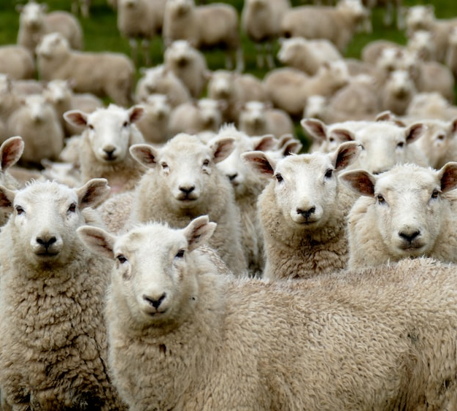
Diverse similar/uniform

Slide 7
Understanding autism
https://www.youtube.com/watch?v=RbwRrVw-CRo

Slide 8
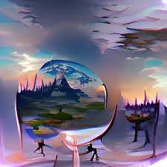
Reflection
Dear Lord
Help us to welcome diversity into our lives and our school.
Help us to include and value those who may be different from us and to see the colour and value that they bring to the world.
Amen

Slide 9
How will you support and include others who are different from you today?

